Slide 1


Adapting Self-Supervised Learning to Histopathology Image Classification
Selahattin Cansız
Mehmet Bahadır Erden
Osman Batur İnce
Image is taken from Heather Barnes on Unsplash
‹#›

Slide 2
Overview
Introduction
Problem Definition
Related Work
Methodology
Experiments
Results

Slide 3
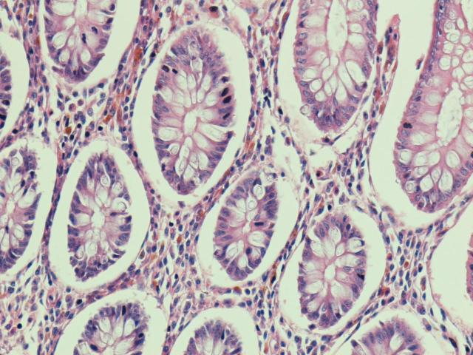
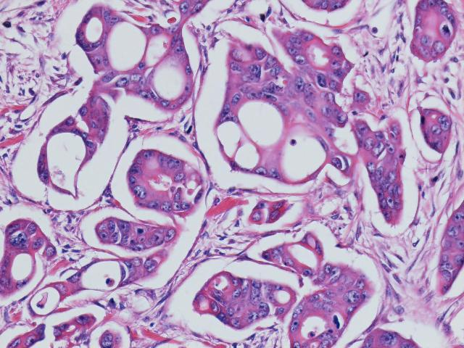
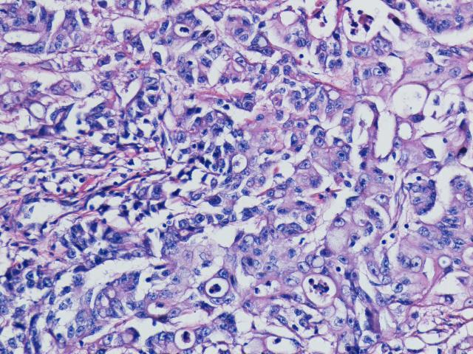
Introduction
Medical imaging in histopathology
Study of detecting pathological (cancerous) cells
Important to get faster results due to medical (e.g. doctor) capacity
Normal cell
Low-grade cell
High-grade cell

Slide 4
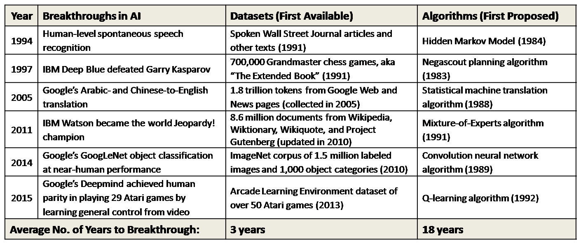
Supervised Learning
The main aim is to predict labels(y) by using input dataset(x)
Creating a model mapping input x to target y
Deep learning can match or exceeded human-level performance
Needs Quality
and Controlled Dataset!!!
Table Credit: Q. Quanto, “Datasets over algorithms,” Space Machine, 31-Mar-2016. [Online]. Available: http://www.spacemachine.net/views/2016/3/datasets-over-algorithms. [Accessed: 23-Jan-2023].

Slide 5
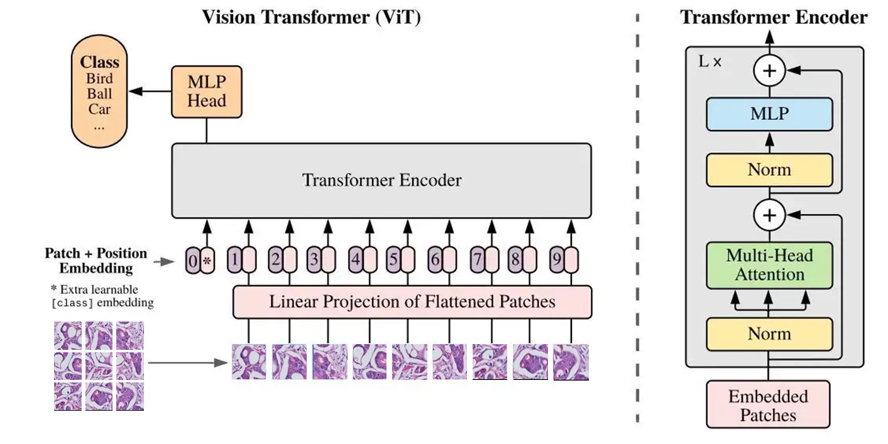
Related Work
RESNET
One of the most influential CNN architectures
Head-to-head versus ViT’s with SotA modifications¹
Vision Transformer (ViT)
An image is worth 16x16 words!
Less inductive bias but more global representations
State-of-the-art results achieved with ViTs
ViT Architecture
Source: Lecture notes
1 A ConvNet for the 2020s, Liu et al., 2022

Slide 6

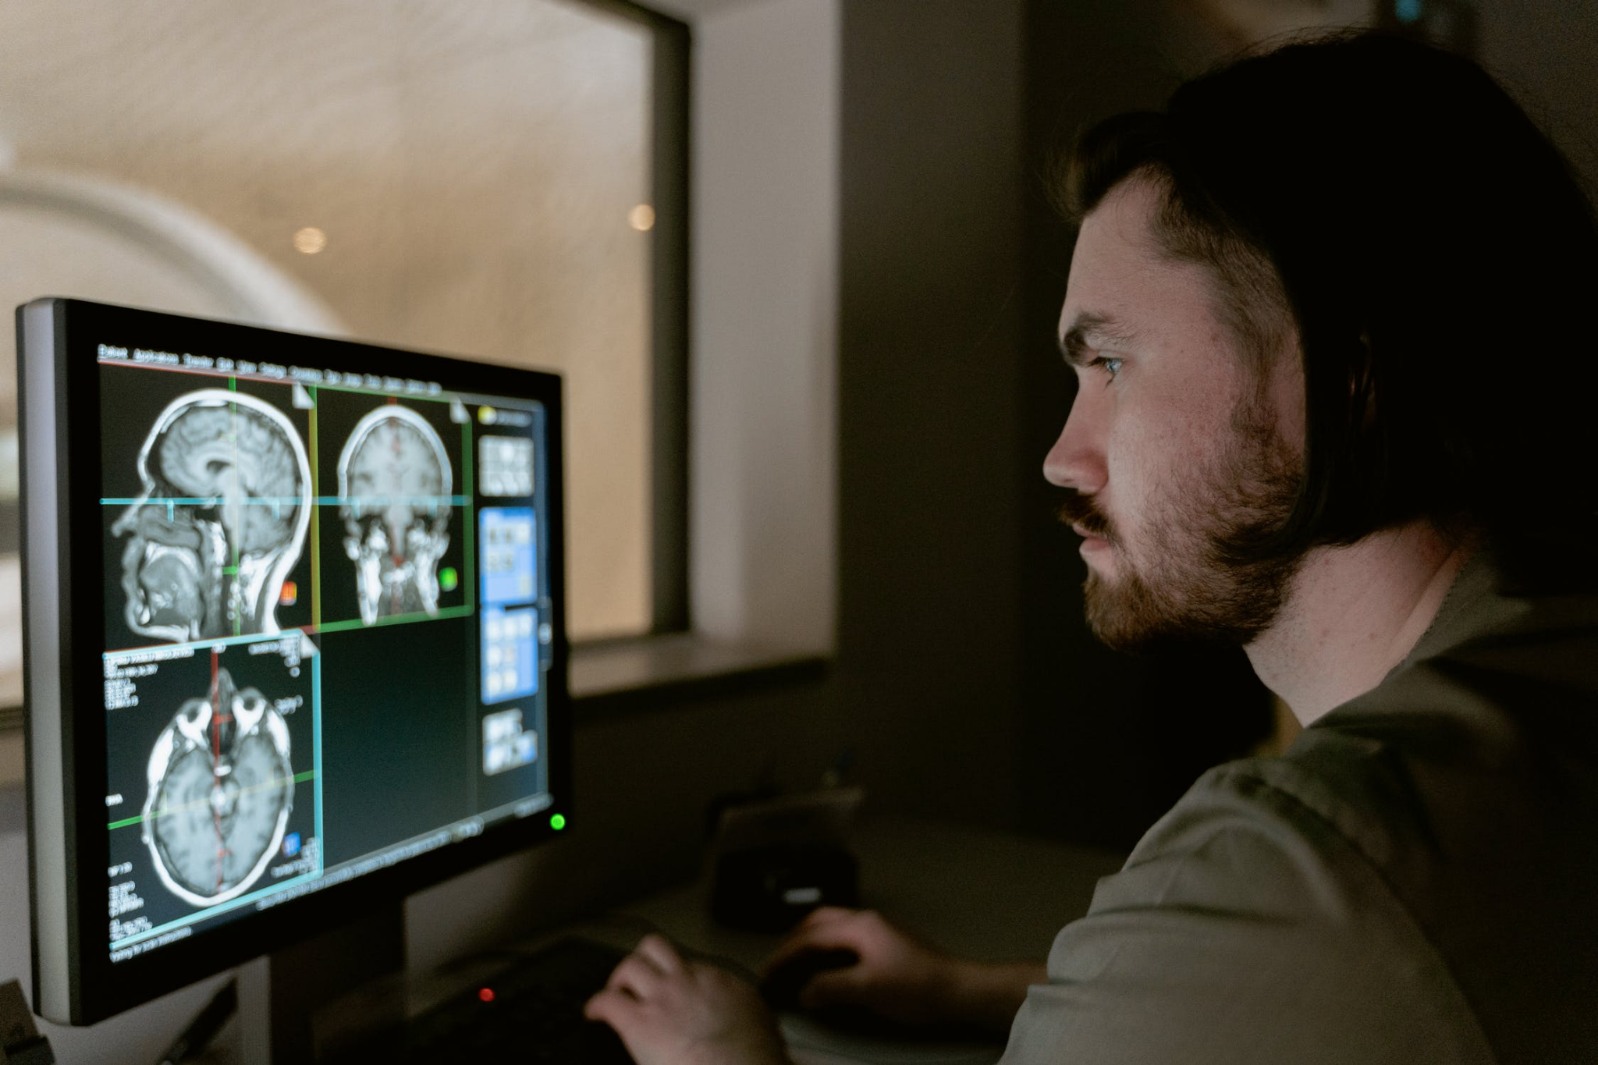
Problem Definition
Medical data is scarce and ethically sensitive
Human-annotated medical data is scarcer! (Shurrab & Duwairi, 2022)
IDEA Use self-supervised learning paradigm to learn representations
First Image Credit: https://www.healthcatalyst.com/insights/5-reasons-healthcare-data-is-difficult-to-measure
Second Image Credit: https://www.tagxdata.com/322/

Slide 7
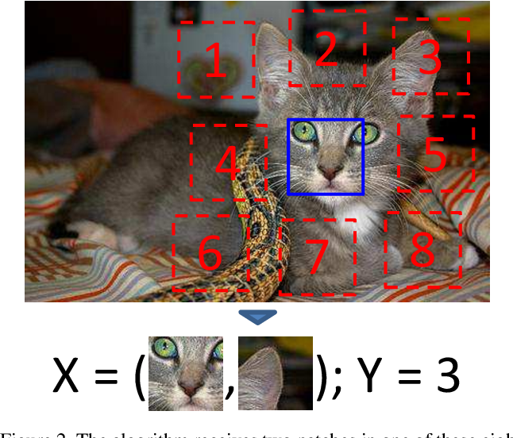
Self-Supervised Learning
Extract some form of supervision from data itself
Main techniques → Predictive, Generative, Contrastive learning
Networks learn pretty good representations!
Context Prediction (Doersch et al, ICCV 2015)
Notes:
Bütün Methodlar’la ilgili resim’e gerek var mı ?

Slide 8

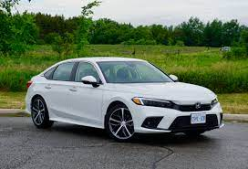
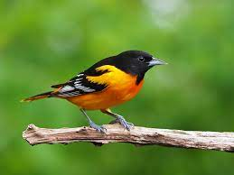
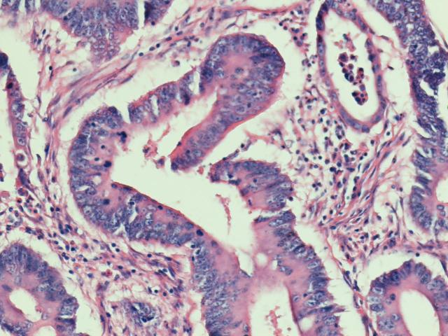
How can self-supervised models be used?
Pretrain
Representation
Pretext
Task
Grade 1
Representation
Finetune
Classifier

Slide 9
Related Work
But which self-supervised technique (SimCLR, MoCo, DINO, …)
should be used in our case?
MEDICAL IMAGING IN HISTOPATHOLOGY
Supervised learning with randomly cropped images over the dataset
Detecting salient regions and extracting features (Sari & Gunduz-Demir, 2018)
SELF-SUPERVISED MEDICAL IMAGING
Using CLIP to detect pathologies from chest X-ray images (Tiu et al, 2022)
Using contrastive predictive coding (CPC) for breast cancer, and lung nodule classification (Lu et al, 2019; Yan et al, 2020)
Using MoCo for COVID diagnosis from X-ray and CT images (Sriram et al, 2021; Chen et al, 2021)
Using SimCLR w/multi-instance learning for chest X-ray images (Azizi et al, 2021)
Notes:
Bu kısımda direk önemsediğimiz şeyin bizim datasetimize benzer bir dataset üstünde çalışma olmamış olmaması ve medical imaging konusunda çok fazla çalışmaya sahip olmayan seçenekleri göz önünde bulundurmak olabilir

Slide 10
Methodologies

Slide 11
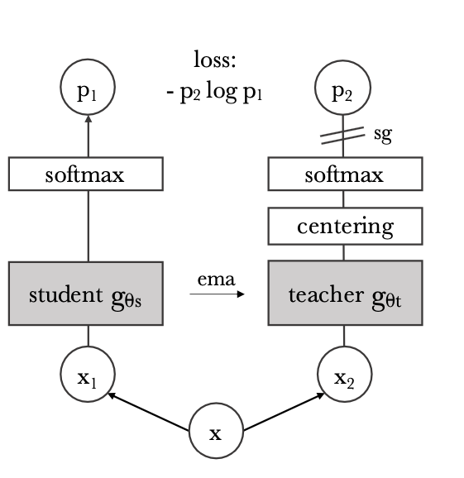
Selected Model
KNOWLEDGE DISTILLATION (DINO)
Student and teacher networks (Same arch., different params)
Pass two different augmented views of an input to networks
Networks output K-dim features, similarity measured w/CE loss
sg → stop gradient, how do we update teacher parameters?
ema → exponential moving average
g_{θt}= (1 — λ)g_{θt} + λg_{θs}
Emerging Properties in Self-Supervised Vision Transformers (Bojanowski et al, 2021)

Slide 12
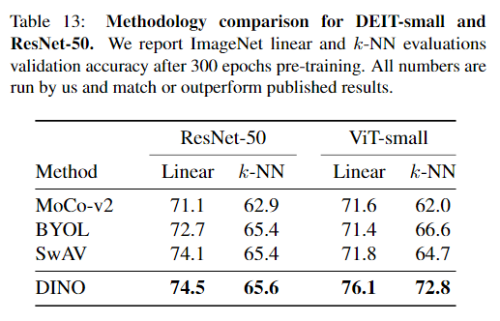
Why DINO?
AND NOT SIMCLR OR OTHER SELF-SUPERVISED TECHNIQUES?
Nov 2019
MoCo
DINO outperforms other models, a strong backbone
More recent work compared to other popular models
Feb 2020
SimCLR
Jun 2020
SimCLR-v2
Feb 2021
CLIP
Apr 2021
DINO
Timeline for Self-Supervised Architectures
Emerging Properties in Self-Supervised Vision Transformers (Bojanowski et al, 2021)

Slide 13
Why DINO?
AND NOT SIMCLR OR OTHER SELF-SUPERVISED TECHNIQUES?
DINO outperforms other models, a strong backbone
Emerging Properties in Self-Supervised Vision Transformers (Bojanowski et al, 2021)

Slide 14
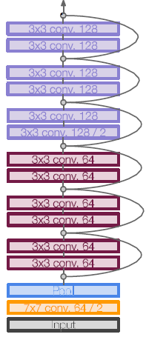
Used Method
Network Architecture
Training Technique
Supervised Learning
From scratch
Fine-tuning (ImageNet)
Self-supervised Learning
DINO (ImageNet)
SimCLR (Medical)
OR
Source: Lecture notes
Source: A. Dosovitskiy et al., “An Image is Worth 16x16 Words: Transformers for Image Recognition at Scale,” 2020 2020, doi: 10.48550/ARXIV.2010.11929.
Notes:
After choosing the self-supervised model type, I want to express our main strategy in the project. [Tık] Firstly, we will use ResNet or Vision Transformer architectures in our experiments to predict the label of the histopathology images.
[Tık] From Training perspective, we decided to train these models from scratch, and fine-tune models pretrained with supervised approach. In the self-supervised manner, pretrained models on both ImageNet and Medical images are used to get predictions.

Slide 15
Used Models
Name | Pre-training | Dataset | Backbone
ResNet (Base) | - | Our dataset | ResNet-50
ViT (Base) | - | Our dataset | ViT (B8*)
ResNet - INet | Supervised | ImageNet | ResNet-50
ResNet - DINO^{[1]} | Self-supervised | ImageNet | ResNet-50
ViT - DINO^{[1]} | Self-supervised | ImageNet | ViT (B8*)
ResNet - (Med)^{[2]} | Self-supervised | Histopathology | ResNet-18
* the B8 term means the big architecture version when the patch size is 8 in the transformer
[1] Code Repository: https://github.com/facebookresearch/dino
[2] Code Repository: https://github.com/ozanciga/self-supervised-histopathology/
Notes:
To make it more clear, firstly, ResNet and Vision Transformer models were trained from scratch with our dataset.
[Tık] Secondly, the ResNet model pretrained with ImageNet was added to understand performance differences between supervised and self-supervised models.
[Tık] Then, ResNet and Vision Transformer with a self-supervised DINO approach was added.
[Tık] Lastly, ResNet model pretrained on histopathology images with SimCLR self-supervised method was also added to observe the effect of DINO.

Slide 16
Experiment Phase
Notes:
In the experiment phase,

Slide 17
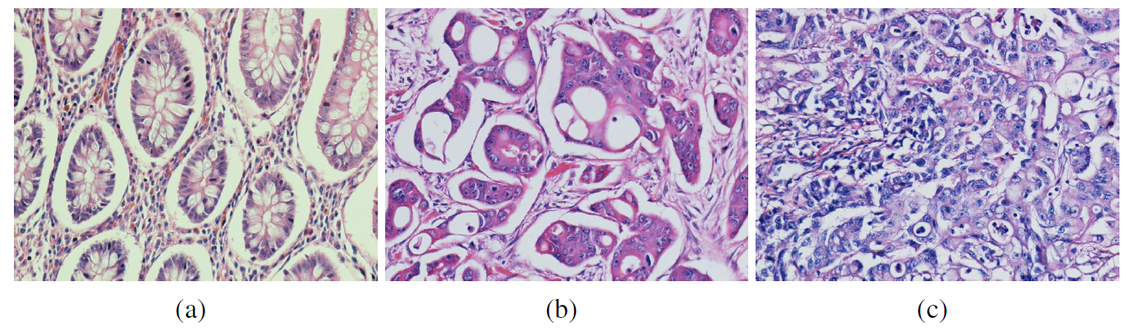
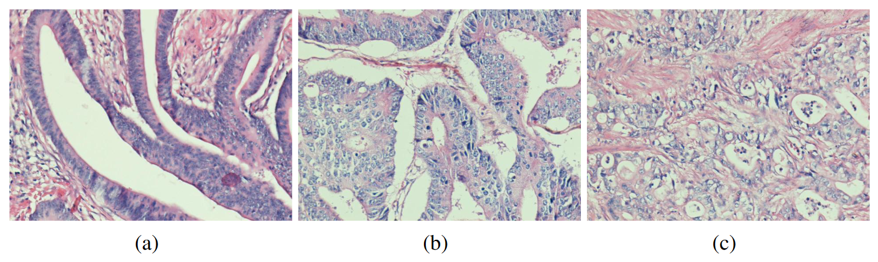
Dataset
2 colon histopathology dataset (3 class & 5 class)
3 class: 3236 images from 258 patients. Normal(1001), Low-grade(1703), and High-grade(532). 1644 images for training set, 1592 images for test set. | 5 class 1421 images from 209 patients Normal(360), Grade 1(367), Grade 1-2(238), Grade 2(247), High-Grade(209). 718 images for training set, 703 images for test set.
Images are split equally into training and test sets by considering patient information
(a) Normal (b) Low-grade (c) High-grade
(a) Grade 1 (b) Grade 1-2 (c) Grade 2
Notes:
Firstly, I want to give some details about used data. Two distinct colon histopathology dataset, including 3 and 5 classes were used in all experiments. In 3 class version, we had more than 3 thousand images and an imbalance problem in targets. In the other one, the Dataset includes nearly 1.4 thousand images with 5 classes, so predicting true classes in this dataset will be more challenging.
In training, we divided datasets into train and test sets equally by considering patient information.

Slide 18
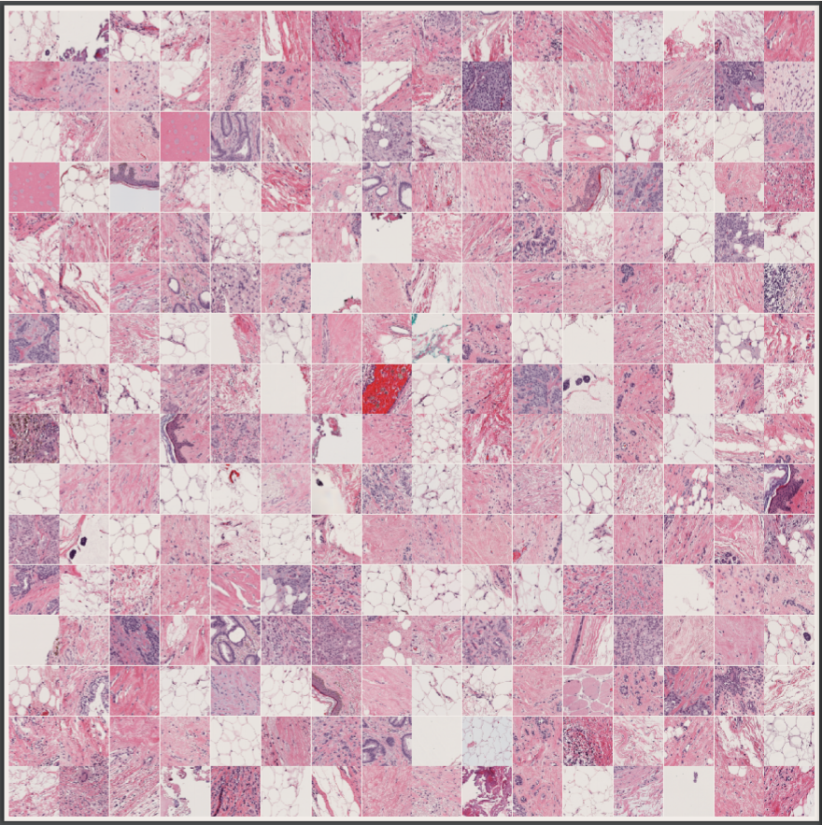
Pre-training Datasets
Large scale image recognition task with 1.4 million images^{[1]}
1000 Object Classes
ResNet-50/ViT + DINO
400 thousand histopathology images^{[2]}
Out of the total 57 datasets (various organs and tissues)
ResNet-18 + SimCLR
[1] Deng, J. et al., 2009. Imagenet: A large-scale hierarchical image database. In 2009 IEEE conference on computer vision and pattern recognition. pp. 248–255.
[2] Created images from whole slides: https://github.com/ozanciga/self-supervised-histopathology/
Notes:
In addition to our dataset, 2 different resources used for pretrained models, these are imagenet and a big histopathology data created from whole slides.

Slide 19

Training Setup
All the parameters in training is initialized with a specific seed
5% of the training data is used as validation to apply early stopping
Determined hyperparameters for the models were very similar to have fair comparison
In training, cross-entropy was selected as a loss function, and Adam was used as an optimizer with the learning rate scheduler ReduceLROnPlateau
Notes:
In training setup, we used the same seed for all parameters in the experiments to compare results fairly. However, multiple runs were also taken to control consistency in results.
[Tık] Secondly, 5 percent of the training data is used for early stopping in training phase
[Tık] We tried to create very similar environments for all models with hyperparameters.
[Tık] Lastly, Cross-entropy and Adam with learning scheduler are used as loss function and optimizer, respectively, in the experiments.
[Tık] Lastly I want to mention one limitation in the project, we could’t integrate self-supervised pretrained ViT model because of bugs and not existing the same architecture.

Slide 20
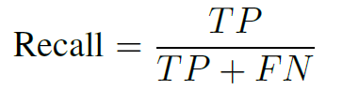
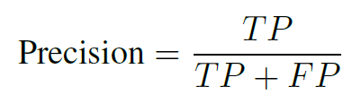
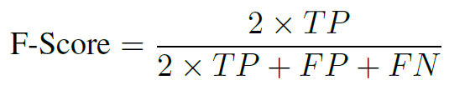
Evaluation Metrics
Fundamental evaluation metrics for classification such as Precision, Recall, and Accuracy are used in the evaluation phase. Macro averaging is used to get general information about models.
F-score will also be used by considering possible imbalances between recall and precision
Class-based results will also be inspected to understand the insight of models deeply
Formula of used metrics
Notes:
In the evaluation phase, well-known performance metrics such as recall, precision, and accuracy were used.
F-Score is also controlled in our experiments to get more reasonable information in imbalance situations.
Moreover, we also analyzed class-based results.

Slide 21
Experiments Setups: OOD Case
Check the models capability for the robustness to out-of-distribution (OoD) problems.
5 class dataset → 3 class dataset
5 Classes
3 Classes
Normal
Normal
Grade 1
Grade 1-2
Low-Grade
Grade 2
High-Grade
High-Grade
Notes:
In addition, we created two different experiment setups. In the first experiment, we tried to generate an out-of-distribution case to understand the capability for the robustness of models. To do that, we converted 5 class datasets to 3 class by merging [Tık] 3 different classes into one class.

Slide 22
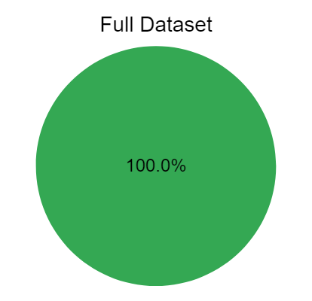
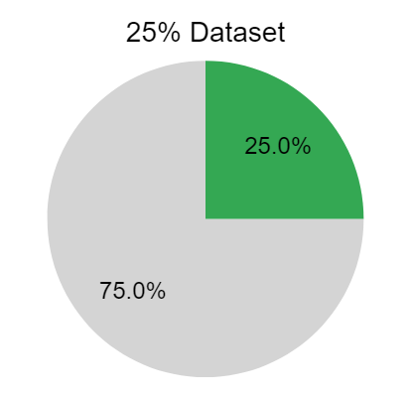
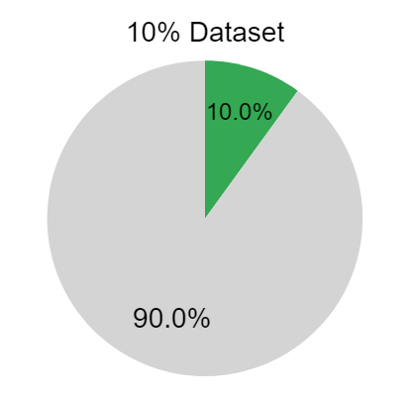
Experiments Setups: Data Scarcity
Experimented the cases when we do not have access to conventional medical datasets
Explored the performance of the models on limited data(10-25 % of the original dataset)
This setup is applied for both three classes and five classes dataset
Initial Situation
First Setup
Second Setup
Notes:
In the second experiment, we decreased the number of training sets even more. One of the main intentions behind this setup is to understand the suitability of the used models for everyone who has a very limited dataset. We decided to use 25 and 10 percent of the training sets in our experiments to observe changes in the results.

Slide 23
Experimental Results

Slide 24
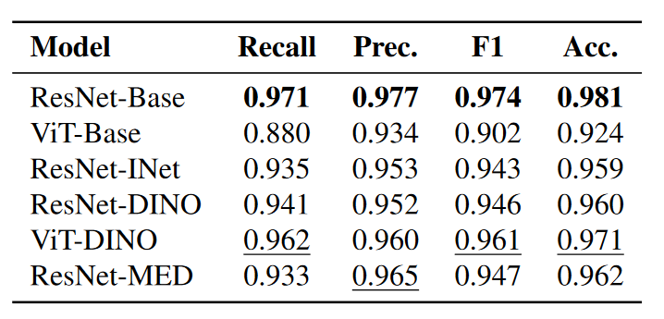
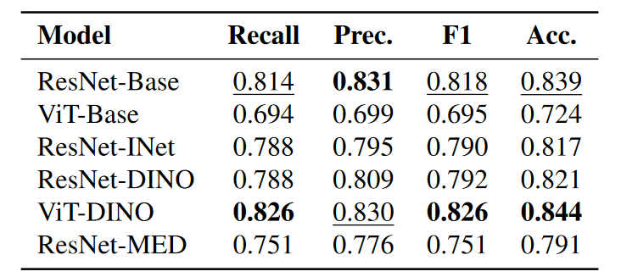
Results - Quantitative (General)
3 class
5 class
Table 1. Best and second best scores for each class are bolded and underlined respectively.
CNNs perform better when trained from scratch
Self-supervised features are effective as supervised features when pretrained on ImageNet.
ViT achieves the closest performance to the base ResNet when pretrained using self-supervision and supervised by finetuning. (outperforms it on more challenging dataset)
Self-supervised pretraining on similar domain leads to promising performance with less complex architectures.
Notes:
A number of experiments have been conducted to analyze the effect of supervised and self-supervised learnings. Here, we observe the general performances of the models on each dataset. In the tables, the best and the second-best models are bolded and underlined respectively. (T) Based on the results, initially we can say that CNNs perform better when trained from scratch. (T) Also, we observe that self-supervised features are effective as supervised features when pretrained on ImageNet. (T) In addition, self-supervised pretrained transformers achieves the closest performance to the best model and even outperforms it on more challenging 5 class dataset. (T) Lastly, domain specific self-supervised model performed well although it has less complexity.

Slide 25
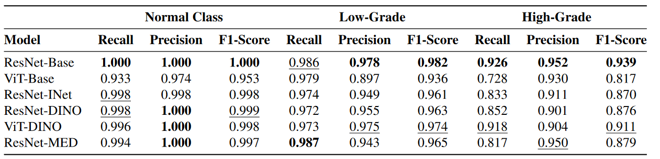
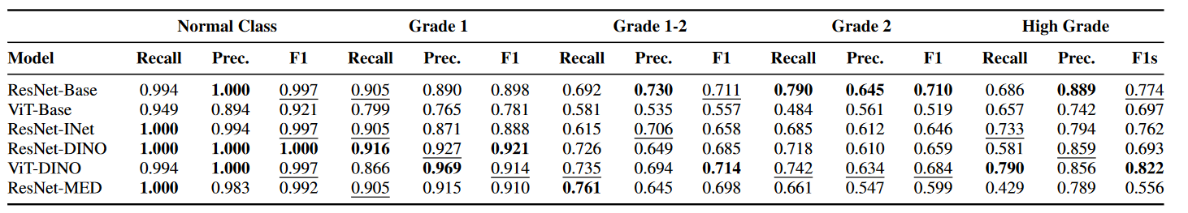
Results - Quantitative (Class-based)
3 class
5 class
Table 2. Classed based performances on each dataset.
Class based performances are consistent with the general performances.
ViT-DINO achieves the best or the second best F-score on more challenging dataset.
Notes:
The class-based performances are consistent with the general results. In 3 class dataset, they have good performance on “normal” and “low-grade” classification. On the other hand, ResNet-Base and ViT-DINO perform better in “high-grade” classification. (T) In addition, on more challenging dataset, ViT-DINO achieves the best or the second-best F-score in each class.

Slide 26
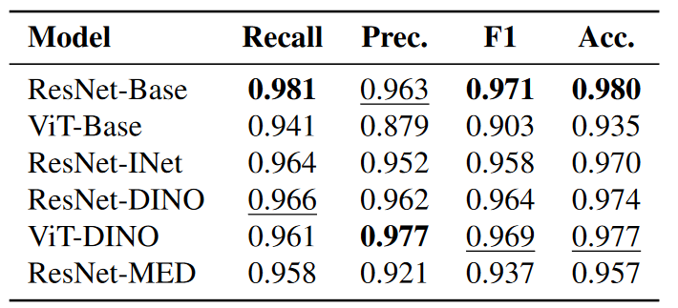
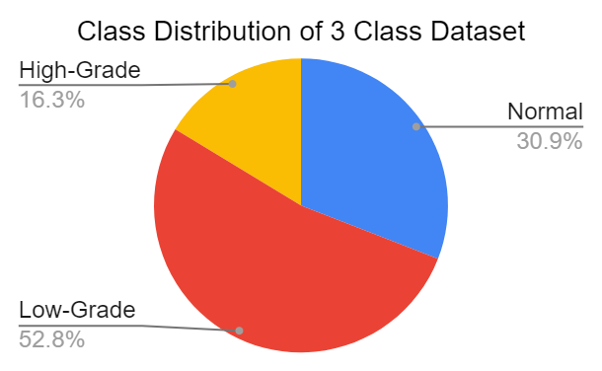
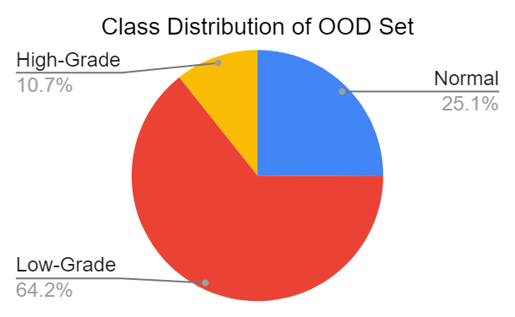
Results - OOD Case
Models comparatively having worse performance on “high-grade” classification achieved better performances.
ResNet-Base and ViT-DINO are more robust to OoD problems.
Notes:
When we analyze the out-of-distribution performances, we observe that models having worse performance on “high-grade” classification achieved better results. Here we want to note that, the test set distributions have changed in ood case. Also, ResNet-Base and ViT-DINO was able to keep their initial performance which indicates their robustness to ood problems.

Slide 27
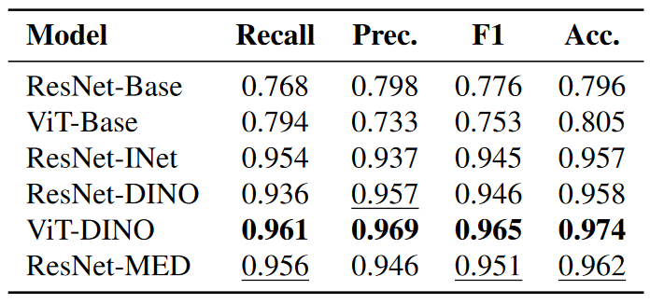
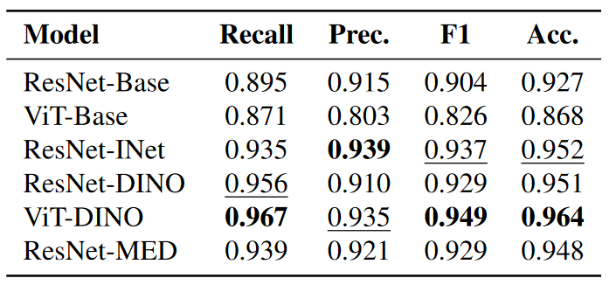
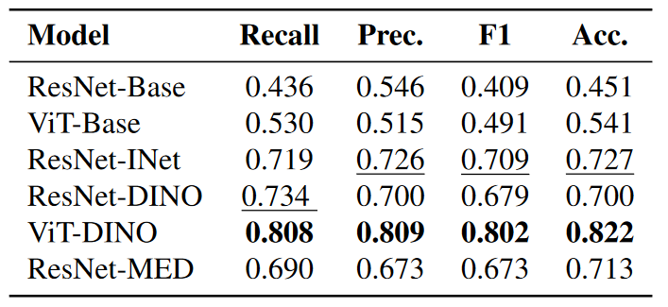
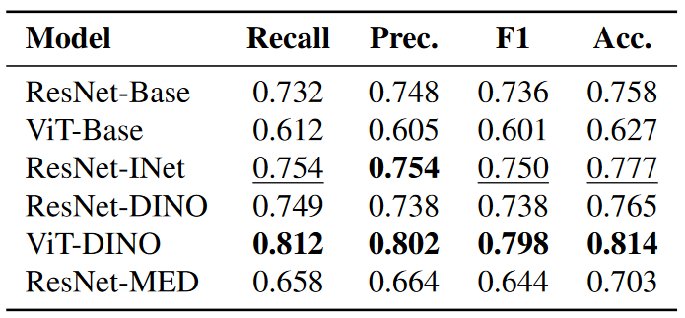
Results - Data Scarcity
Data percentage: 10%
Data percentage: 25%
3 class
5 class
As expected, CNNs and ViTs perform worse with the low data.
Self-supervised pretraining with ViTs is highly effective as it doesn't lose much from its performance although it uses less data.
Notes:
In medical domain, datasets are smaller and often contains less labelled data. Thus, to experiment this condition, we used some portion of the original datasets. As expected, CNNs and ViTs perform worse with the low data. More surprisingly, self-supervised pretrained ViT achieved the best performance with considerable margin while keeping close to full dataset performances.

Slide 28
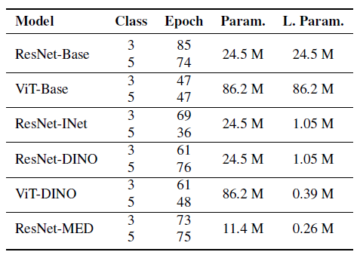
Number of Parameters in Models
Created methods were also controlled in terms of the number of parameters and length of the training period
All models stopped under 100 epochs and the number of classes in the target did not affect drastically the length of the training period
The number of the learnable parameters in ResNet models exceeds ViT model because of the difference in the last layer of the models
Table 2. Parameter and Learnable Parameter counts and training
epoch count for each mode
Notes:
We also compare the number of learnable parameters in each model. (T) ViT-DINO has the least number of learnable parameters among the pretrained models although it achieves the best performance.

Slide 29
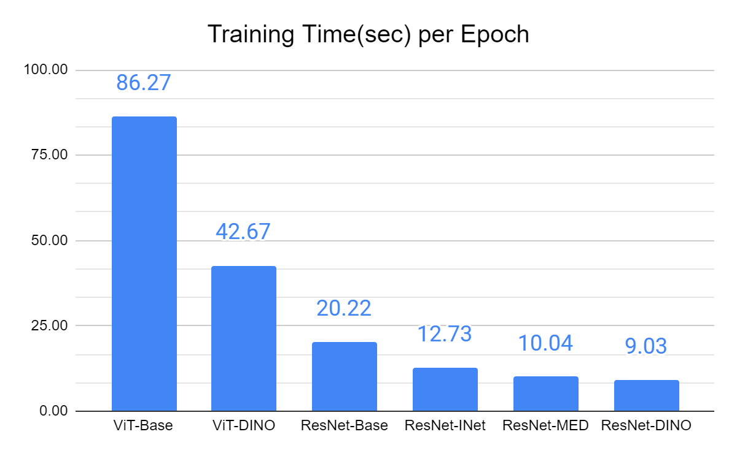
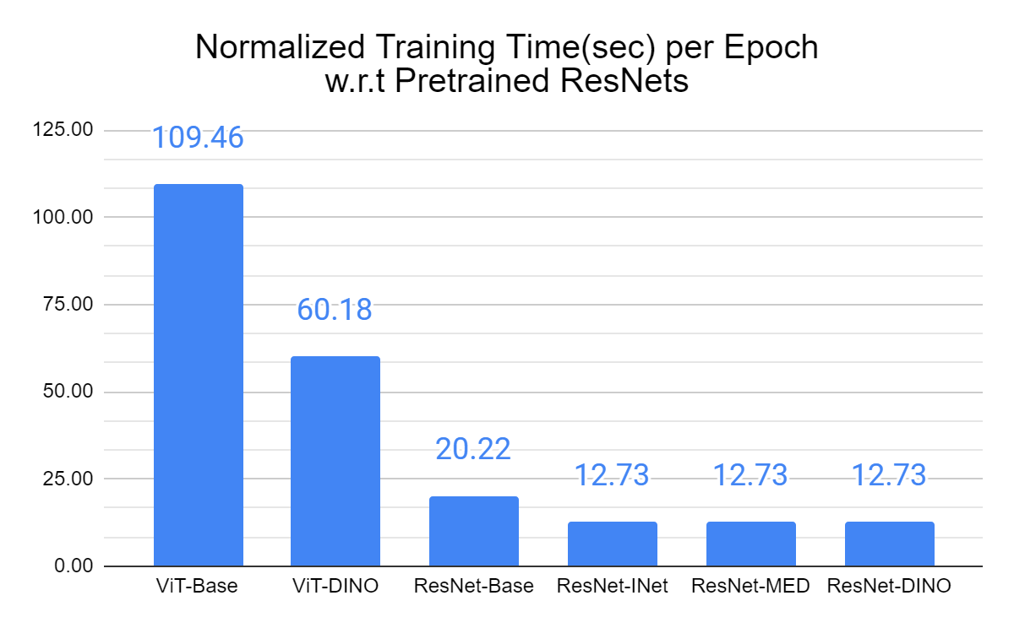
Training Time
It is hard to get exact training time per epoch because there are a number of external factor such as how many job is processed at the same time, bottlenecks in nodes, etc.
We both added obtained training time in experiments and normalized training time by expecting similar training times for pretrained ResNet models trained in different periods.
Notes:
As for the training times, we observe that training the transformers takes longer while the CNNs could be trained in much shorter time. By the way, the ResNet architecture takes the advantage of self-supervised features to converge faster.

Slide 30
Results - Qualitative

Slide 31
Conclusions

Slide 32
Conclusions
In medical domain, obtaining labelled dataset requires expert annotation,thus costly.
Self-supervised pretrained ViTs achieves promising results as CNNs which were trained from scratch with large datasets.
When the data is scarce, self-supervised ViTs outperforms newly trained and pretrained models.
Self-supervised learning leads to better contextual representations than supervised learning.
Transfer learning to medical domain also works well (no need to have large pretrained models in medical domain).
Notes:
Here, we summarized the outcomes inferred from all experiments. Since obtaining labelled dataset is costly in medical domain, pretrained models are useful to get promising results with small datasets. Especially, transformers pretrained with self-supervised methods outperforms other models by utilizing better contextual representations. Lastly, transfer learning to medical domain works well. So, at least in our case, we did not need to large pretrained models in medical domain.

Slide 33
Thanks for your attention

Slide 34

Limitations
Limitation: An equivalent pretrained ViT model could not be integrated. Similar models have some bugs[1] or differences[2].
[1] https://github.com/lukemelas/PyTorch-Pretrained-ViT/issues/16
[2] https://huggingface.co/docs/transformers/model_doc/vit

Slide 35
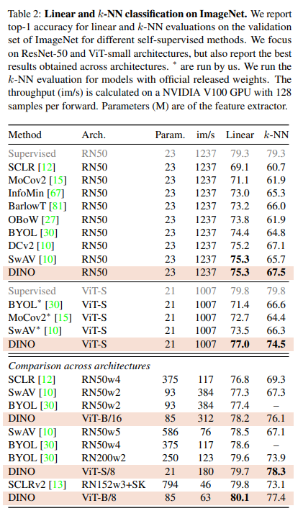
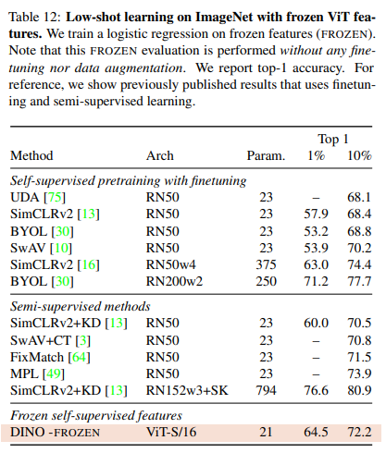
Why DINO?
Emerging Properties in Self-Supervised Vision Transformers (Bojanowski et al, 2021)

